Slide 1
10 Minutes
1 Minutes
2 Minutes
3 Minutes
4 Minutes
5 Minutes
6 Minutes
7 Minutes
8 Minutes
9 Minutes

Slide 2
Therefore, if anyone is in Christ, he is a new creation. The old has passed away; behold, the new has come. - 2 Corinthians 5:17
Happy New Year
2024

Slide 3
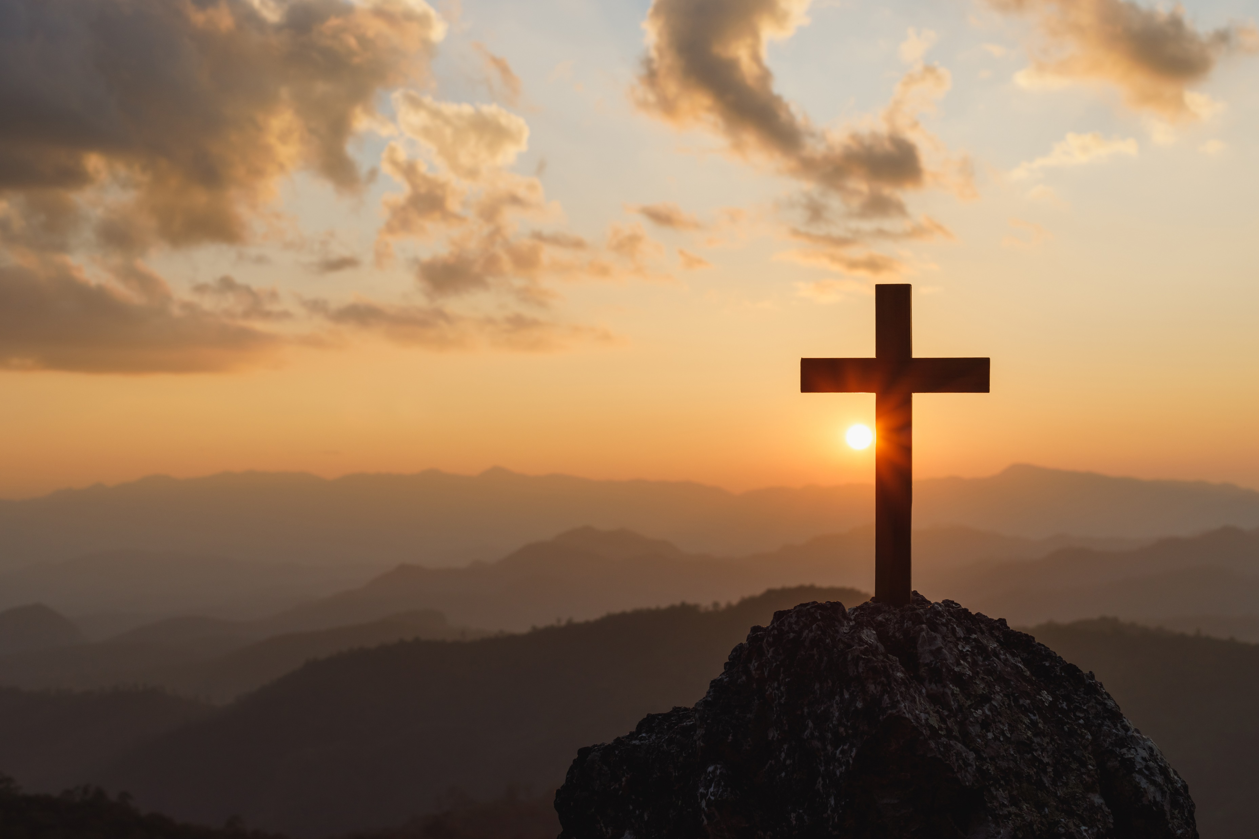
Order of Service
The Morning Greeting
Prayer Requests
Lots of Prayer Requests
Announcements
Happy New Year
Men’s Meeting
Remind everyone of the website: https://www.abner-baptist.org
Music (Singing)
There is Power in the Blood #101
Nothing But the Blood #122
O How I Love Jesus #131
Sermon
Christmas, the next day
Lord I’m Coming Home #113
Alter Call
Closing Prayer

Slide 4
Good Morning
Welcome to Abner Baptist Church
Notes:
Good Morning Abner Baptist Church.
It’s wonderful to see all of your bright smiling faces this morning.
I want to introduce myself in case any of you don’t know me.
My name is Tony DeGonia.
I do hold a position here at the church. It is NOT Music Minister…
I am the Director of Technology for Abner Baptist Church.
I want everyone to pray for this church to attract a Music Leader, because until we get one that is good at you might be stuck with one that is just willing.
If this is what GOD wants me to do, I will do it until I am old and gray and can barely croak out the words, or for the next six months or so, whichever comes first.

Slide 5
Welcome
Let’s welcome each other, the guests and greet your neighbor
Notes:
Let’s welcome each other, the guests and greet your neighbor, Shake someone’ hand, give them a hug and make them feel WELCOME!!!!

Slide 6
Prayer Requests
Do we have any prayer requests?

Slide 7
Prayer Requests
Stan Howeth – Rushed to hospital with High Heart Rate and High Blood Pressure
Ms. Dot’s Family in their time of mourning
Miss Margaret McSpadden
Mrs. Helen Brand
Brenda McFadden
Gail Brand (Brother Dale’s dau.-in-law)
Mrs. Pam Tallant
Notes:
Miss Margaret
Mrs. Helen Brand
Gail Brand (Brother Dale’s daughter-in-law)
Pray for Israel
Pray for the United States, and our first responders, who are under attack too often.
Our military and our leaders
Tony and Cayse DeGonia – Pray for Tony to be blessed with gainful employment again soon.

Slide 8
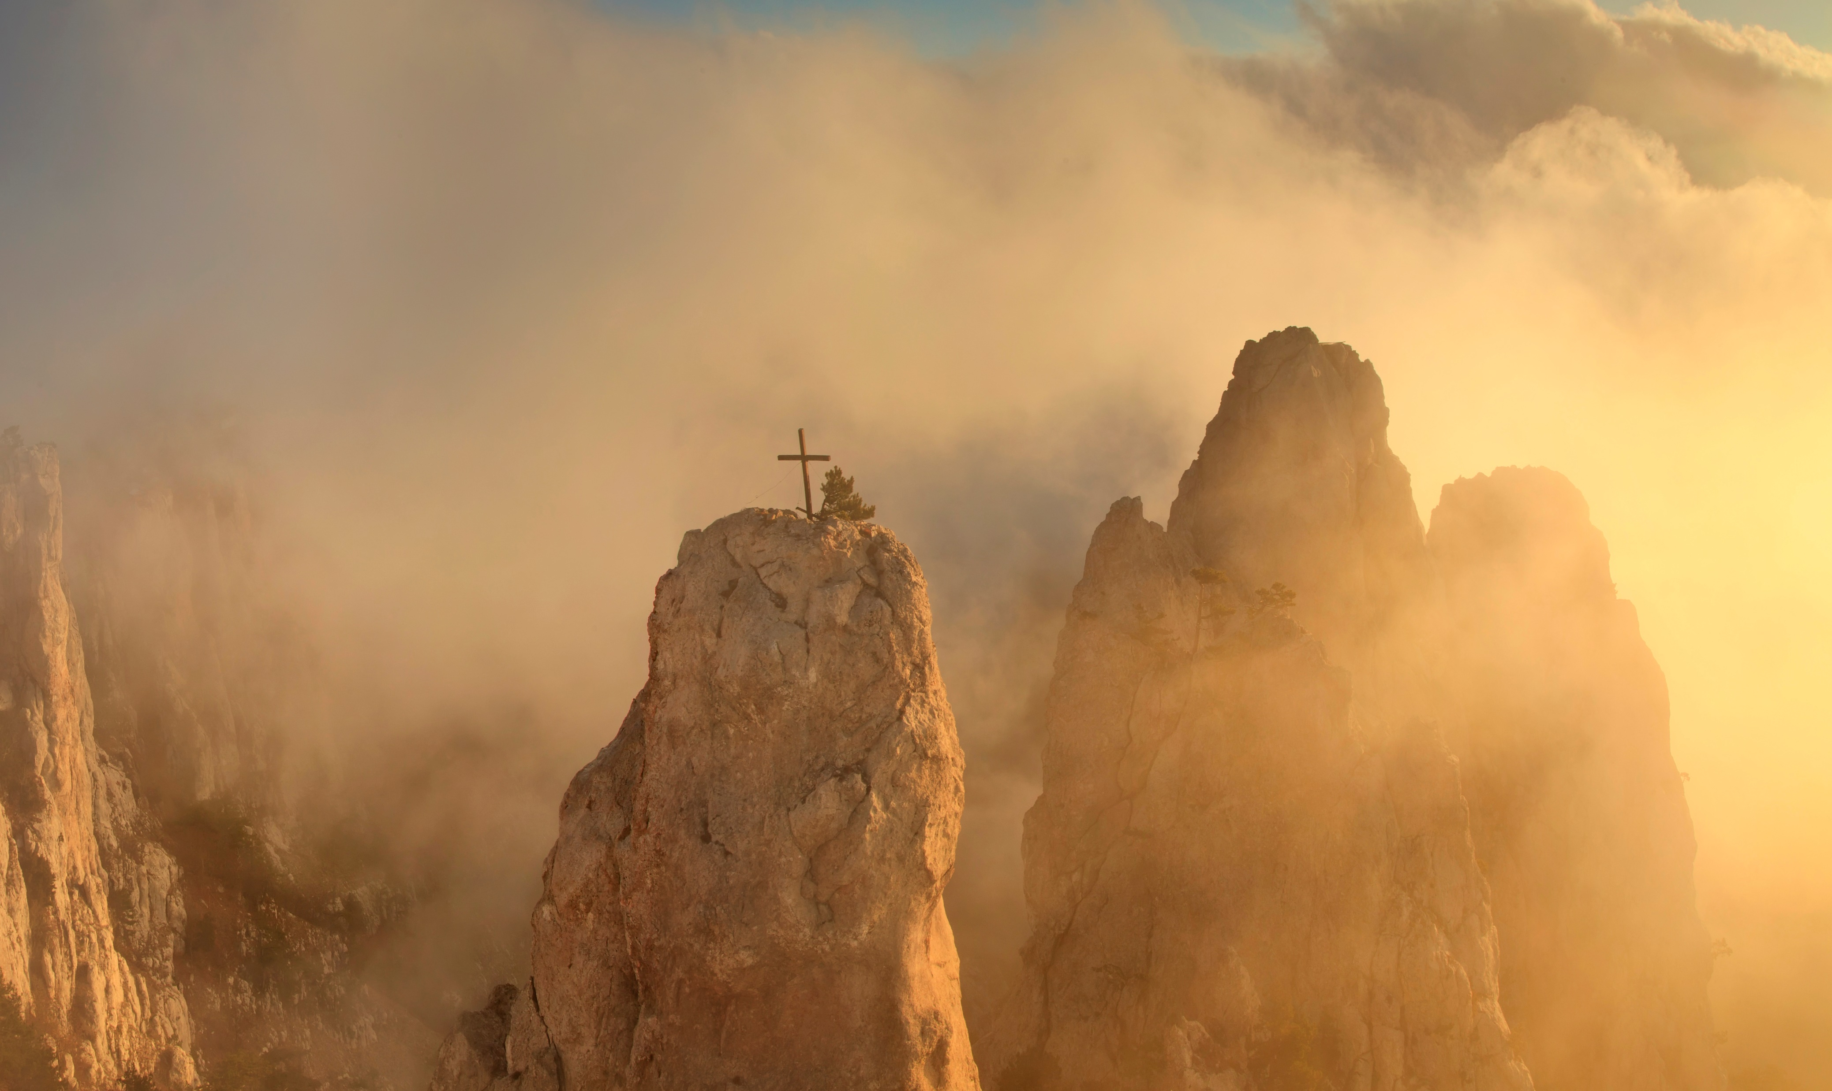
Prayer Requests
Tony and Cayse DeGonia – Tony a job
Cody, Bella, and Maeve – Safe travels to CO.
Pray for Israel
Pray for the United States, and our first responders, who are under attack too often.
Our military and elected our leaders
For our church to grow and bring glory to GOD.
Notes:
Miss Margaret
Mrs. Helen Brand
Gail Brand (Brother Dale’s daughter-in-law)
Pray for Israel
Pray for the United States, and our first responders, who are under attack too often.
Our military and our leaders
Tony and Cayse DeGonia – Pray for Tony to be blessed with gainful employment again soon.

Slide 9
Announcements

Slide 10
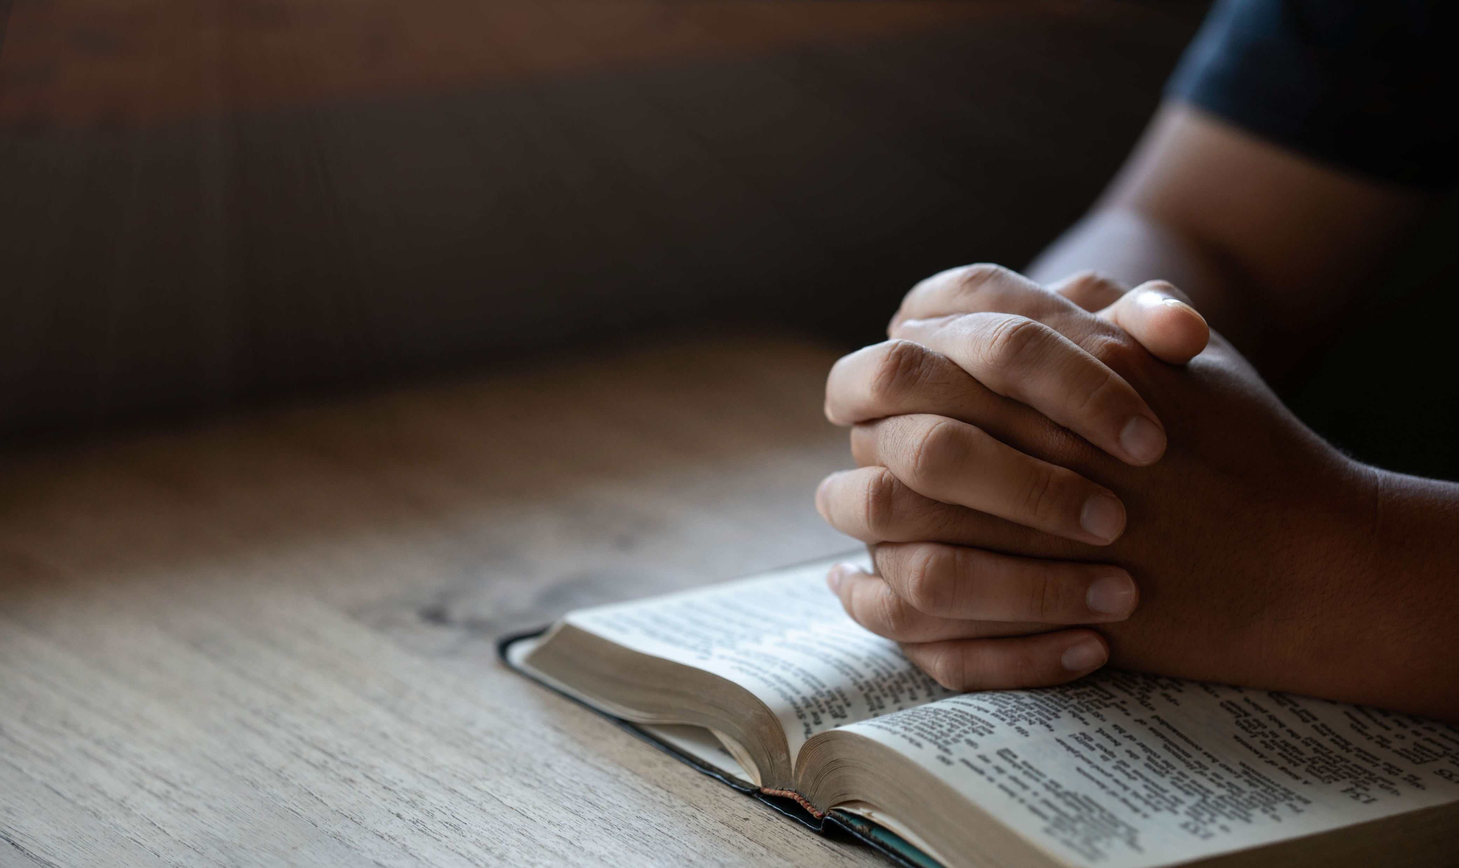
Announcements
Wishing all a Safe and Happy New Year
The second (2nd) Saturday of each month we will be holding a men’s meeting @ 5 PM.
Don’t forget about our new website @https://www.abner-baptist.org

Slide 11
Let’s get ready to

Slide 12
There is Power in the Blood
#101
in our blue hymnals
Notes:
There is Power in the Blood #101
Nothing But the Blood #122
O How I Love Jesus #131

Slide 13
#101 There is Power in the Blood
Would you be free from the burden of sin?
There's pow'r in the blood, pow'r in the blood;
Would you o'er evil a victory win?
There's wonderful pow'r in the blood.
Notes:
There is Power in the Blood #101
Nothing But the Blood #122
O How I Love Jesus #131

Slide 14
#101 There is Power in the Blood
Refrain: There is pow'r, pow'r, wonder-working pow'r In the blood of the Lamb; There is pow'r, pow'r, wonder-working pow'r In the precious blood of the Lamb.
Notes:
There is Power in the Blood #101
Nothing But the Blood #122
O How I Love Jesus #131

Slide 15
#101 There is Power in the Blood
Would you be free from your passion and pride?
There's pow'r in the blood, pow'r in the blood;
Come for a cleansing to Calvary's tide–
There's wonderful pow'r in the blood.

Slide 16
#101 There is Power in the Blood
Refrain: There is pow'r, pow'r, wonder-working pow'r In the blood of the Lamb; There is pow'r, pow'r, wonder-working pow'r In the precious blood of the Lamb.
Notes:
There is Power in the Blood #101
Nothing But the Blood #122
O How I Love Jesus #131

Slide 17
#101 There is Power in the Blood
Would you be whiter, yes brighter than snow? There's pow'r in the blood, pow'r in the blood; Sin-stains are lost in its life-giving flow– There's wonderful pow'r in the blood.
Notes:
There is Power in the Blood #101
Nothing But the Blood #122
O How I Love Jesus #131

Slide 18
#101 There is Power in the Blood
Refrain: There is pow'r, pow'r, wonder-working pow'r In the blood of the Lamb; There is pow'r, pow'r, wonder-working pow'r In the precious blood of the Lamb.
Notes:
There is Power in the Blood #101
Nothing But the Blood #122
O How I Love Jesus #131

Slide 19
#101 There is Power in the Blood
Would you do service for Jesus, your King? There's pow'r in the blood, pow'r in the blood; Would you live daily His praises to sing? There's wonderful pow'r in the blood.

Slide 20
#101 There is Power in the Blood
Refrain: There is pow'r, pow'r, wonder-working pow'r In the blood of the Lamb; There is pow'r, pow'r, wonder-working pow'r In the precious blood of the Lamb.
Notes:
There is Power in the Blood #101
Nothing But the Blood #122
O How I Love Jesus #131

Slide 21
Nothing but the Blood
#122
in our blue hymnals
Notes:
There is Power in the Blood #101
Nothing But the Blood #122
O How I Love Jesus #131

Slide 22
#122 Nothing But the Blood
What can wash away my sin? Nothing but the blood of Jesus. What can make me whole again? Nothing but the blood of Jesus.

Slide 23
#122 Nothing But the Blood
Refrain: O precious is the flow that makes me white as snow; no other fount I know; nothing but the blood of Jesus.

Slide 24
#122 Nothing But the Blood
For my pardon this I see: nothing but the blood of Jesus. For my cleansing this my plea: nothing but the blood of Jesus.

Slide 25
#122 Nothing But the Blood
Refrain: O precious is the flow that makes me white as snow; no other fount I know; nothing but the blood of Jesus.

Slide 26
#122 Nothing But the Blood
Nothing can for sin atone: nothing but the blood of Jesus. Naught of good that I have done: nothing but the blood of Jesus.

Slide 27
#122 Nothing But the Blood
Refrain: O precious is the flow that makes me white as snow; no other fount I know; nothing but the blood of Jesus.

Slide 28
#122 Nothing But the Blood
This is all my hope and peace: nothing but the blood of Jesus. This is all my righteousness: nothing but the blood of Jesus.

Slide 29
#122 Nothing But the Blood
Refrain: O precious is the flow that makes me white as snow; no other fount I know; nothing but the blood of Jesus.

Slide 30
Offering
Scott and Walter

Slide 31
O How I Love Jesus
#131
in our blue hymnals
Notes:
There is Power in the Blood #101
Nothing But the Blood #122
O How I Love Jesus #131

Slide 32
#131 O How I Love Jesus
There is a name I love to hear, I love to sing its worth; it sounds like music in my ear, the sweetest name on earth.

Slide 33
#131 O How I Love Jesus
Refrain: O how I love Jesus, O how I love Jesus, O how I love Jesus, because he first loved me!

Slide 34
#131 O How I Love Jesus
It tells me of a Savior's love, who died to set me free; it tells me of his precious blood, the sinner's perfect plea.

Slide 35
#131 O How I Love Jesus
Refrain: O how I love Jesus, O how I love Jesus, O how I love Jesus, because he first loved me!

Slide 36
#131 O How I Love Jesus
It tells of one whose loving heart can feel my deepest woe; who in each sorrow bears a part that none can bear below.

Slide 37
#131 O How I Love Jesus
Refrain: O how I love Jesus, O how I love Jesus, O how I love Jesus, because he first loved me!

Slide 38
Prayer for today’s message
Today’s Message

Slide 39
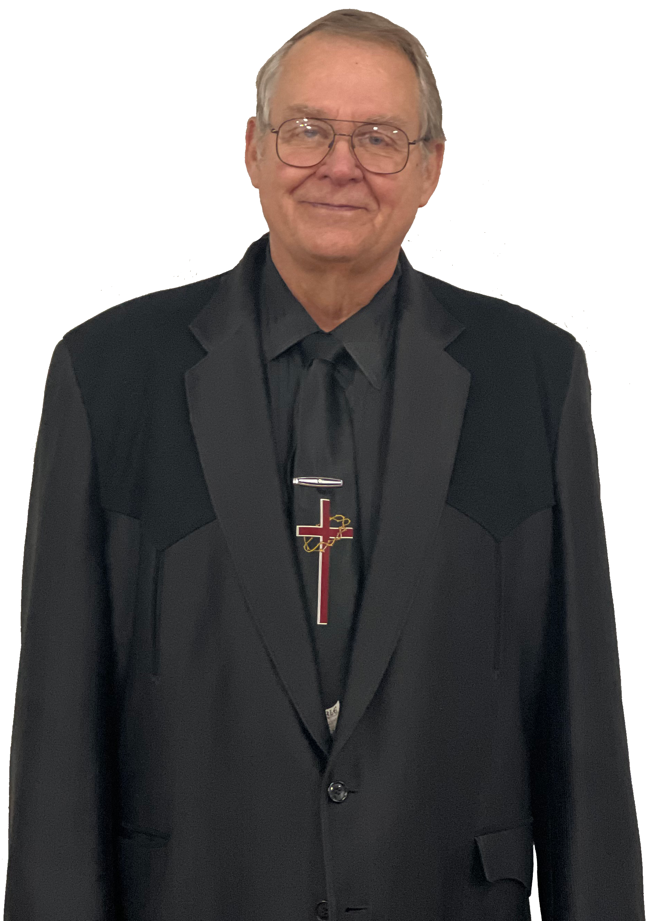
Christmas, the next day
Today’s Message
Brother Dale Brand

Slide 40
Today’s Message
Matthew 2: 11,12
¹ And when they were come into the house, they saw the young child with Mary his mother, and fell down, and worshipped him: and when they had opened their treasures, they presented unto him gifts; gold, and frankincense and myrrh.
¹² And being warned of God in a dream that they should not return to Herod, they departed into their own country another way.

Slide 41
Reason #1
A person can never be the same after having a child;

Slide 42
Today’s Message
a
when a baby is born;
b
people come to see the baby

Slide 43
Reason #2
Mary and Joseph;

Slide 44
Reason #2
a
Their lives were changed
b
They had to move;

Slide 45
Reason #3
Mary and Joseph raised Jesus;

Slide 46
Reason #3
a
They nurtured their relationship with Jesus;
b
You grow as a child grows;

Slide 47
Reason #4
Mary kept the saying of Jesus in her heart
Luke 2:19 - ”But Mary kept all these things, and pondered them in her heart.”

Slide 48
Reason #4
a
Her life and ours have been change;
b
Has your life changed;

Slide 49
#113
Lord I’m Coming Home

Slide 50
#113 Lord I’m Coming Home
I've wandered far away from God, Now I'm coming home; The paths of sin too long I've trod, Lord, I'm coming home.

Slide 51
#113 Lord I’m Coming Home
Refrain: Coming home, coming home, Nevermore to roam, Open wide Thine arms of love, Lord, I'm coming home.

Slide 52
#113 Lord I’m Coming Home
I've wasted many precious years, Now I'm coming home; I now repent with bitter tears, Lord, I'm coming home.

Slide 53
#113 Lord I’m Coming Home
Refrain: Coming home, coming home, Nevermore to roam, Open wide Thine arms of love, Lord, I'm coming home.

Slide 54
#113 Lord I’m Coming Home
Can we find a friend so faithful who will all our sorrows share? Jesus knows our every weakness; take it to the Lord in prayer!

Slide 55
#113 Lord I’m Coming Home
Refrain: Coming home, coming home, Nevermore to roam, Open wide Thine arms of love, Lord, I'm coming home.

Slide 56
#113 Lord I’m Coming Home
I've tired of sin and straying, Lord, Now I'm coming home; I'll trust Thy love, believe Thy word, Lord, I'm coming home.

Slide 57
#113 Lord I’m Coming Home
Refrain: Coming home, coming home, Nevermore to roam, Open wide Thine arms of love, Lord, I'm coming home.

Slide 58
#113 Lord I’m Coming Home
My soul is sick, my heart is sore, Now I'm coming home; My strength renew, my hope restore, Lord, I'm coming home.

Slide 59
#113 Lord I’m Coming Home
Refrain: Coming home, coming home, Nevermore to roam, Open wide Thine arms of love, Lord, I'm coming home.

Slide 60
In Closing
Let Us Pray.

Slide 61
Be Blessed
Have a safe and Happy New Year. We will see you here next Sunday.

