Slide 1
10 Minutes
1 Minutes
2 Minutes
3 Minutes
4 Minutes
5 Minutes
6 Minutes
7 Minutes
8 Minutes
9 Minutes

Slide 2
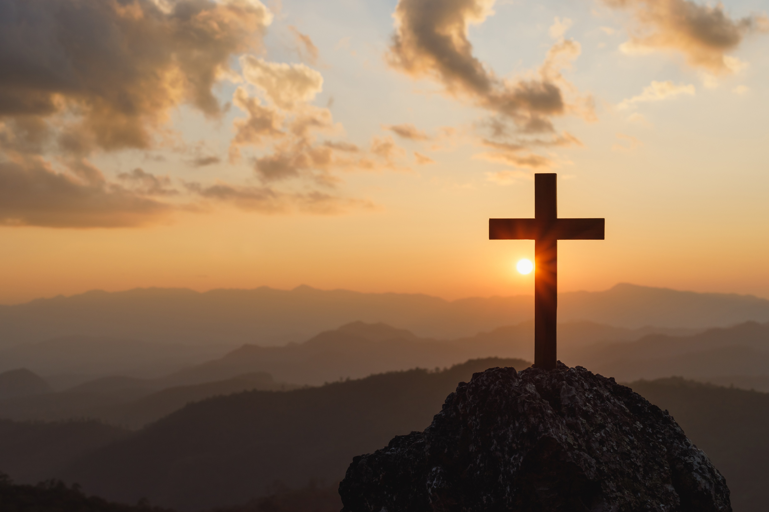
Order of Service
The Morning Greeting
Prayer Requests
Announcements
Merry Christmas
Men’s Meeting
Remind everyone of the website: https://www.abner-baptist.org
Music (Singing)
I’ll Fly Away #54
Away in the Manger #279
Offering (Scott and Walter)
Silent Night, Holy Night #278
Sermon
If you do only one thing…
What a friend we have in Jesus #295
Alter Call
Closing Prayer

Slide 3
Good Morning
Welcome to Abner Baptist Church
Notes:
Good Morning Abner Baptist Church.
It’s wonderful to see all of your bright smiling faces this morning.
I want to introduce myself in case any of you don’t know me.
My name is Tony DeGonia.
I do hold a position here at the church. It is NOT Music Minister…
I am the Director of Technology for Abner Baptist Church.
I want everyone to pray for this church to attract a Music Leader, because until we get one that is good at you might be stuck with one that is just willing.
If this is what GOD wants me to do, I will do it until I am old and gray and can barely croak out the words, or for the next six months or so, whichever comes first.

Slide 4
Welcome
Let’s welcome each other, the guests and greet your neighbor
Notes:
Let’s welcome each other, the guests and greet your neighbor, Shake someone’ hand, give them a hug and make them feel WELCOME!!!!

Slide 5
Prayer Requests
Do we have any prayer requests?

Slide 6
Prayer Requests
Miss Margaret
Mrs. Helen Brand
Gail Brand (Brother Dale’s daughter-in-law)
Pray for Israel
Pray for the United States, and our first responders, who are under attack too often.
Our military and our leaders
Tony and Cayse DeGonia – Pray for Tony to be blessed with gainful employment again soon.
Notes:
Miss Margaret
Mrs. Helen Brand
Gail Brand (Brother Dale’s daughter-in-law)
Pray for Israel
Pray for the United States, and our first responders, who are under attack too often.
Our military and our leaders
Tony and Cayse DeGonia – Pray for Tony to be blessed with gainful employment again soon.

Slide 7
Announcements

Slide 8
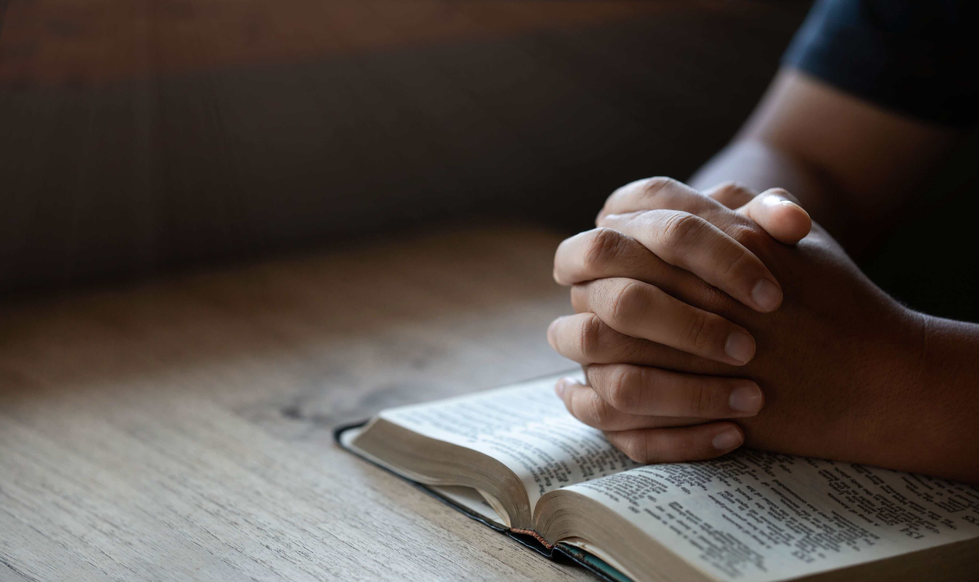
Announcements
Wishing all a Merry Christmas and a Happy New Year
The second (2nd) Saturday of each month we will be holding a brother meeting
Don’t forget about our new website @https://www.abner-baptist.org

Slide 9
Let’s get ready to

Slide 10
I’ll fly away
#54
in our blue hymnals

Slide 11
#54 I’ll fly away
Some glad morning when this life is over I'll fly away To a home on God's celestial shore I'll fly away

Slide 12
#54 I’ll fly away
I'll fly away, oh, Glory I'll fly away When I die, Hallelujah, by and by I'll fly away

Slide 13
#54 I’ll fly away
Just a few more weary days and then I'll fly away To a land where joy shall never end I'll fly away

Slide 14
#54 I’ll fly away
I'll fly away, oh, Glory I'll fly away When I die, Hallelujah, by and by I'll fly away

Slide 15
#54 I’ll fly away
Yeah, when I die, Hallelujah,
by and by
I'll fly away

Slide 16
Away in the manger
#279
in our blue hymnals

Slide 17
#279 Away in the manger
Away in a manger, no crib for a bed, The little Lord Jesus laid down His sweet head. The stars in the sky all looked down where He lay, The little Lord Jesus, asleep on the hay.

Slide 18
#279 Away in the manger
The cattle are lowing, the Baby awakes,
The little Lord Jesus, no crying He makes.
I love Thee, Lord Jesus! Look down from the sky,
And stay by my side until morning is nigh.

Slide 19
#279 Away in the manger
Be near me, Lord Jesus! I ask Thee to stay
Close by me forever, and love me, I pray.
Bless all the dear children in Thy tender care,
And fit us for heaven, to live with Thee there.

Slide 20
Offering
Scott and Walter

Slide 21
Silent night
#278
in our blue hymnals

Slide 22
#278 Silent Night
Silent night! Holy night! All is calm, all is bright ’round yon virgin mother and child! Holy infant, so tender and mild, sleep in heavenly peace, sleep in heavenly peace.

Slide 23
#278 Silent Night
Silent night! Holy night!
Shepherds quake at the sight.
Glories stream from heaven afar,
heav'nly hosts sing, “Alleluia!
Christ the Savior is born!
Christ the Savior is born!”

Slide 24
#278 Silent Night
Silent night! Holy night!
Son of God, love’s pure light
radiant beams from Thy holy face
with the dawn of redeeming grace,
Jesus, Lord, at Thy birth!
Jesus, Lord, at Thy birth!

Slide 25
#278 Silent Night
Silent night! Holy night!
Wondrous star, lend thy light;
with the angels let us sing
“Alleluia" to our King:
“Christ the Savior is born!
Christ the Savior is born.”

Slide 26
Prayer for today’s message
Today’s Message

Slide 27
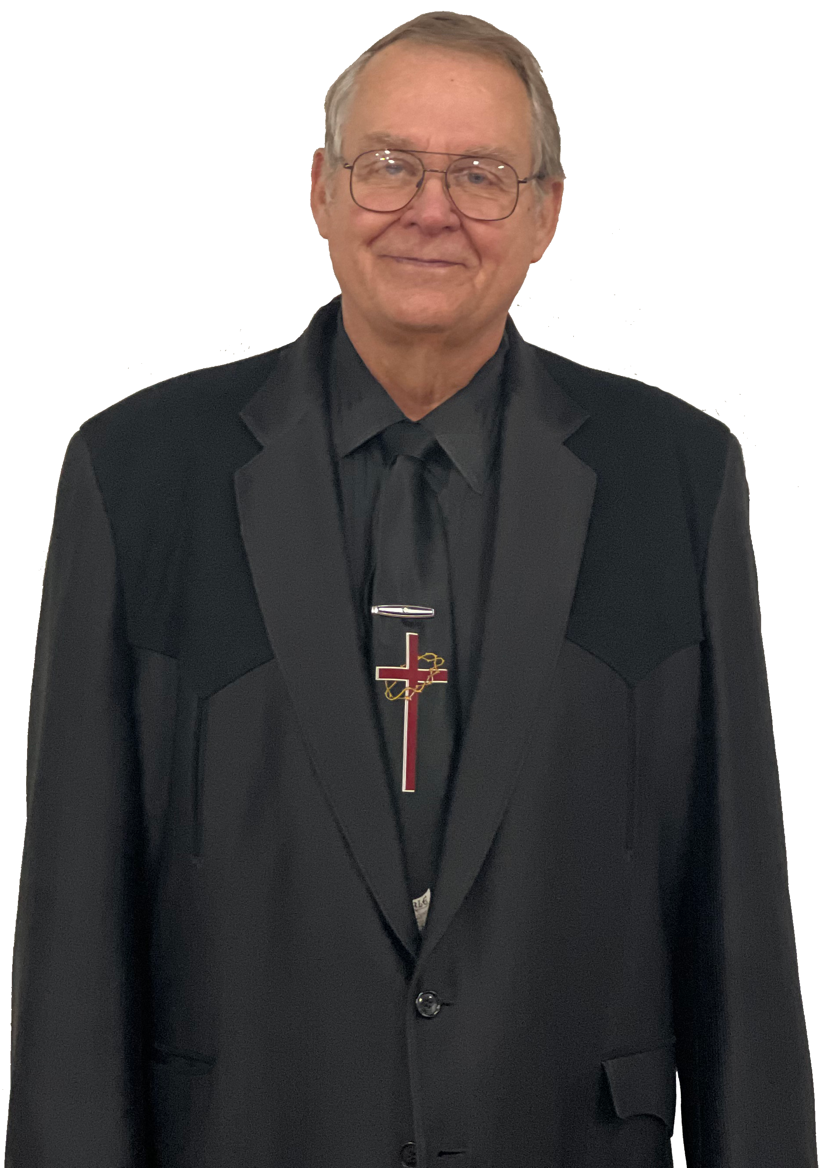
If You Do Only One Thing…
Today’s Message
Brother Dale Brand

Slide 28
Today’s Message
Colossians 4:2 “Continue in Prayer and watch in the same with thanksgiving.”

Slide 29
Reason #1
Devote Yourselves to Prayer

Slide 30
Today’s Message
a
The word devote is also translated as “to adhere to, to persist in, or to busy oneself with”
b
By praying we will keep our minds on Jesus

Slide 31
Reason #2
Why should we pray?

Slide 32
Reason #2
a
Because it is our duty as Christians.
b
c
1 Thessalonians 5:17. Tells us to “pray without ceasing.”
1
Because we are promised that God hears.
“The righteous cry, and the Lord heareth, and delivereth them out of all their troubles”
d
Because we need to hear from God.

Slide 33
Reason #3
Because we need help to overcome our own will.

Slide 34
Reason #3
a
When Jesus prayed in the garden he said, not my will but thine.
b
That’s why we pray, so that his will gets done instead of ours.

Slide 35
Reason #4
We pray because we need help for what lies ahead of us.

Slide 36
Reason #4
a
It might be: Surgery, a job change, some of us are facing some major choices ahead of us.
b
Psalms says show me thy ways, O Lord teach me thy paths…

Slide 37
Reason #5
We pray because we need help for what lies ahead of us.

Slide 38
Reason #5
a
When I give a Bible to someone, I always write in it: “This Bible will keep you from sin, and sin will keep you from this Bible.”
b
It is us that breaks the communion from God, not Him from us.

Slide 39
#295
What a Friend we have in Jesus

Slide 40
#295
What a friend we have in Jesus, all our sins and griefs to bear! What a privilege to carry everything to God in prayer!

Slide 41
#295
O what peace we often forfeit, O what needless pain we bear, all because we do not carry everything to God in prayer!

Slide 42
#295
Have we trials and temptations? Is there trouble anywhere? We should never be discouraged; take it to the Lord in prayer!

Slide 43
#295
Can we find a friend so faithful who will all our sorrows share? Jesus knows our every weakness; take it to the Lord in prayer!

Slide 44
#295
Are we weak and heavy-laden, cumbered with a load of care? Precious Savior, still our refuge-- take it to the Lord in prayer!

Slide 45
#295
Do your friends despise, forsake you? Take it to the Lord in prayer! In his arms he'll take and shield you; you will find a solace there.

Slide 46
In Closing
Let Us Pray.

Slide 47
Be Blessed
Have a very Merry Christmas and we will see you here next Sunday.

