Slide 1



10 Minutes
1 Minutes
2 Minutes
3 Minutes
4 Minutes
5 Minutes
6 Minutes
7 Minutes
8 Minutes
9 Minutes

Slide 2
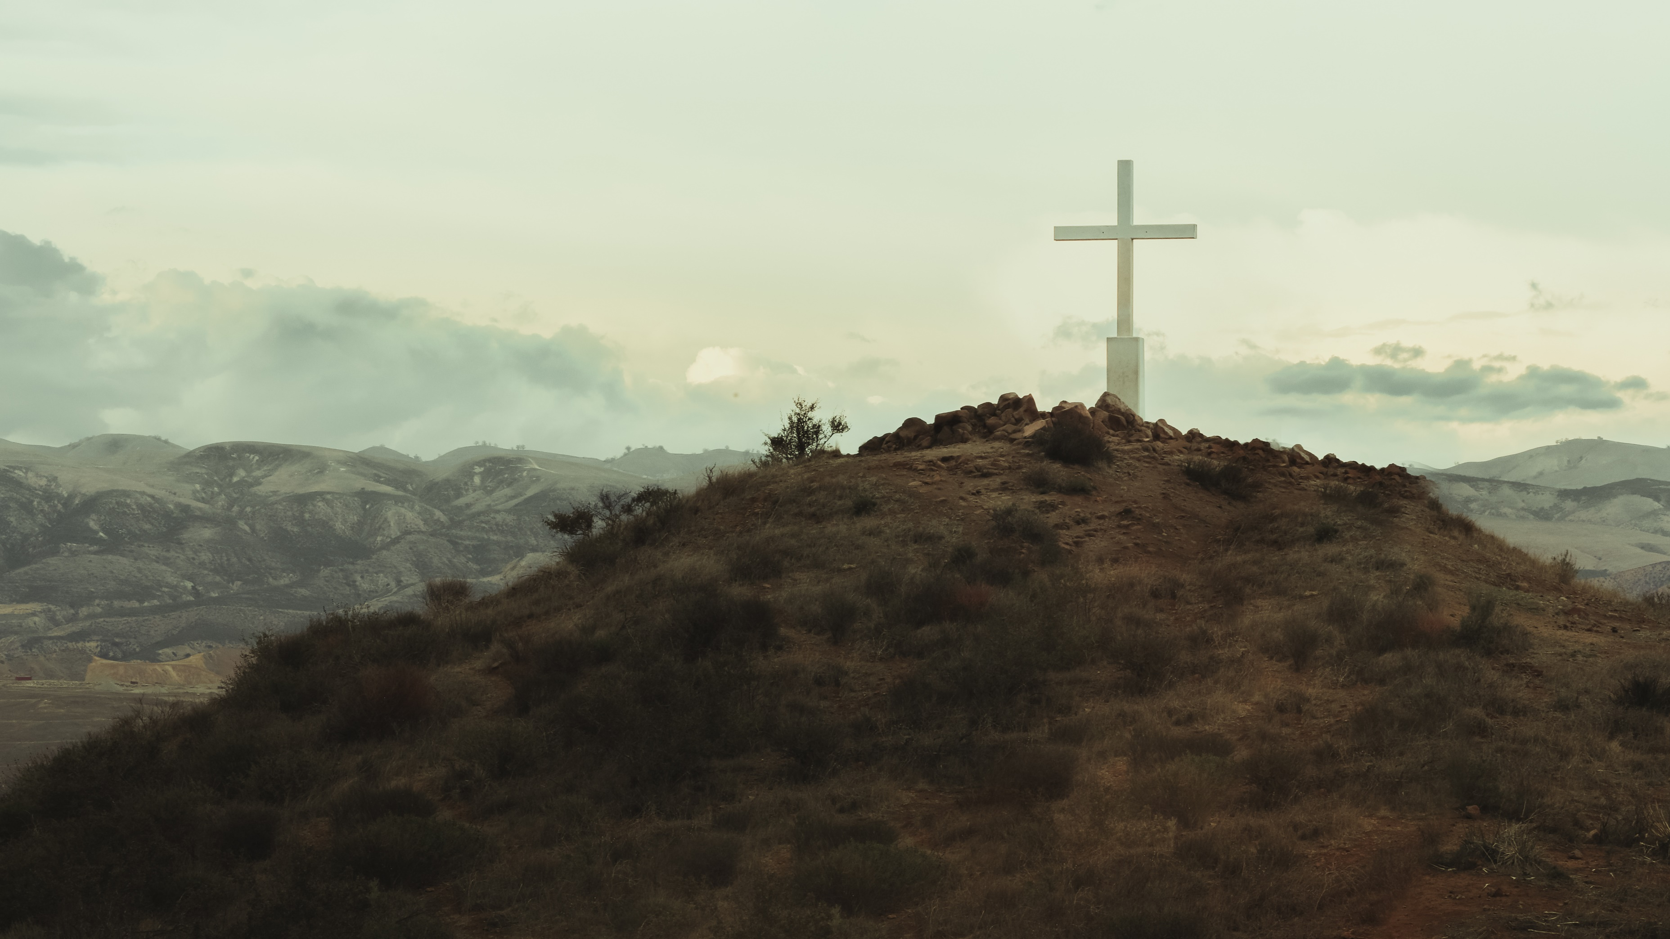
Therefore, if anyone is in Christ, he is a new creation. The old has passed away; behold, the new has come. - 2 Corinthians 5:17
Happy New Year
2024

Slide 3
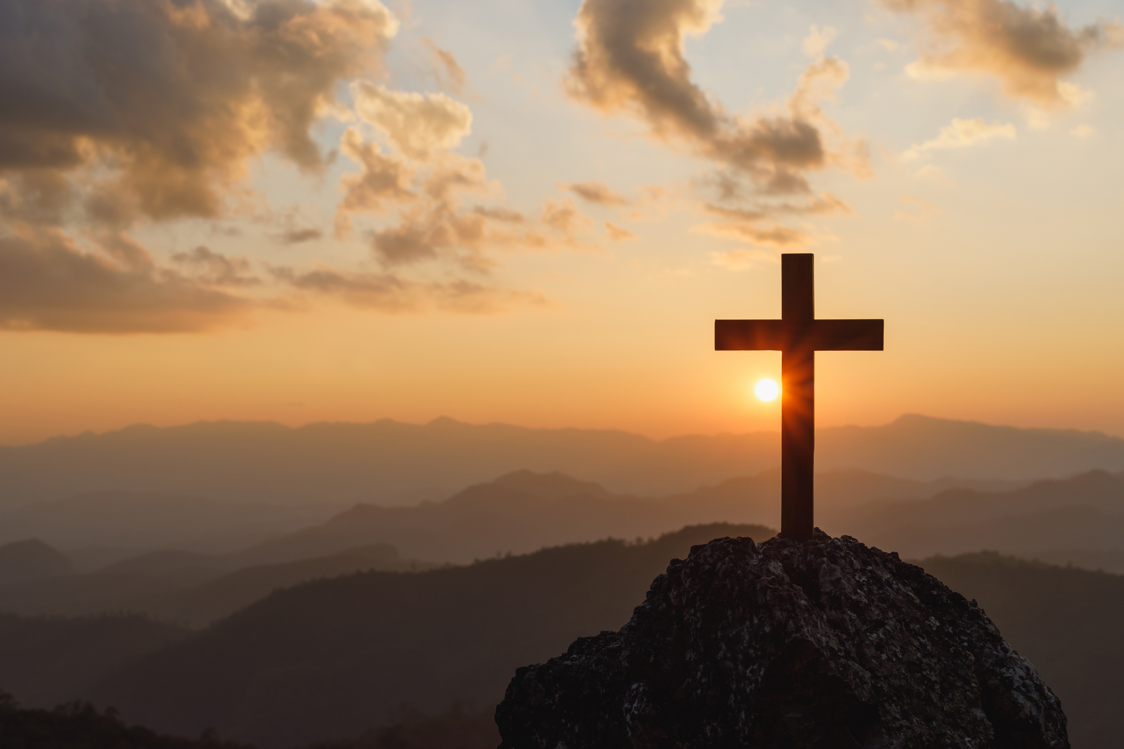
Order of Service
The Morning Greeting
Prayer Requests
  Lots of Prayer Requests
Announcements
  Happy New Year
  Men’s Meeting
  https://www.abner-baptist.org
Worship
  Specials Request
  O How I Love Jesus #131
  Specials
  Tis So Sweet to Trust in Jesus #104
  Just As I Am #124
Sermon
  Christmas, the next day
  Softly and Tenderly #105
  Alter Call
Closing Prayer
Notes:
Specials Request
O How I Love Jesus #131
Specials
Tis So Sweet to Trust in Jesus #104
Just As I Am #124
Softly and Tenderly #105

Slide 4
Good Morning
Welcome to Abner Baptist Church
Notes:
Good Morning Abner Baptist Church.
It’s wonderful to see all of your bright smiling faces this morning.
I want to introduce myself in case any of you don’t know me.
My name is Tony DeGonia.
I do hold a position here at the church. It is NOT Music Minister…
I am the Director of Technology for Abner Baptist Church.
I want everyone to pray for this church to attract a Music Leader, because until we get one that is good at you might be stuck with one that is just willing.
If this is what GOD wants me to do, I will do it until I am old and gray and can barely croak out the words, or for the next six months or so, whichever comes first.

Slide 5
Welcome
Let’s welcome each other, the guests and greet your neighbor
Notes:
Let’s welcome each other, the guests and greet your neighbor, Shake someone’ hand, give them a hug and make them feel WELCOME!!!!

Slide 6
Prayer Requests
Do we have any prayer requests?

Slide 7

Prayer Requests
Stan Howeth
Ms. Dot’s Family
Miss Margaret McSpadden
Mrs. Helen Brand
Brenda McFadden
Gail Brand (Brother Dale’s daughter-in-law)
Mrs. Pam Tallant
Notes:
Miss Margaret
Mrs. Helen Brand
Gail Brand (Brother Dale’s daughter-in-law)
Pray for Israel
Pray for the United States, and our first responders, who are under attack too often.
Our military and our leaders
Tony and Cayse DeGonia – Pray for Tony to be blessed with gainful employment again soon.

Slide 8
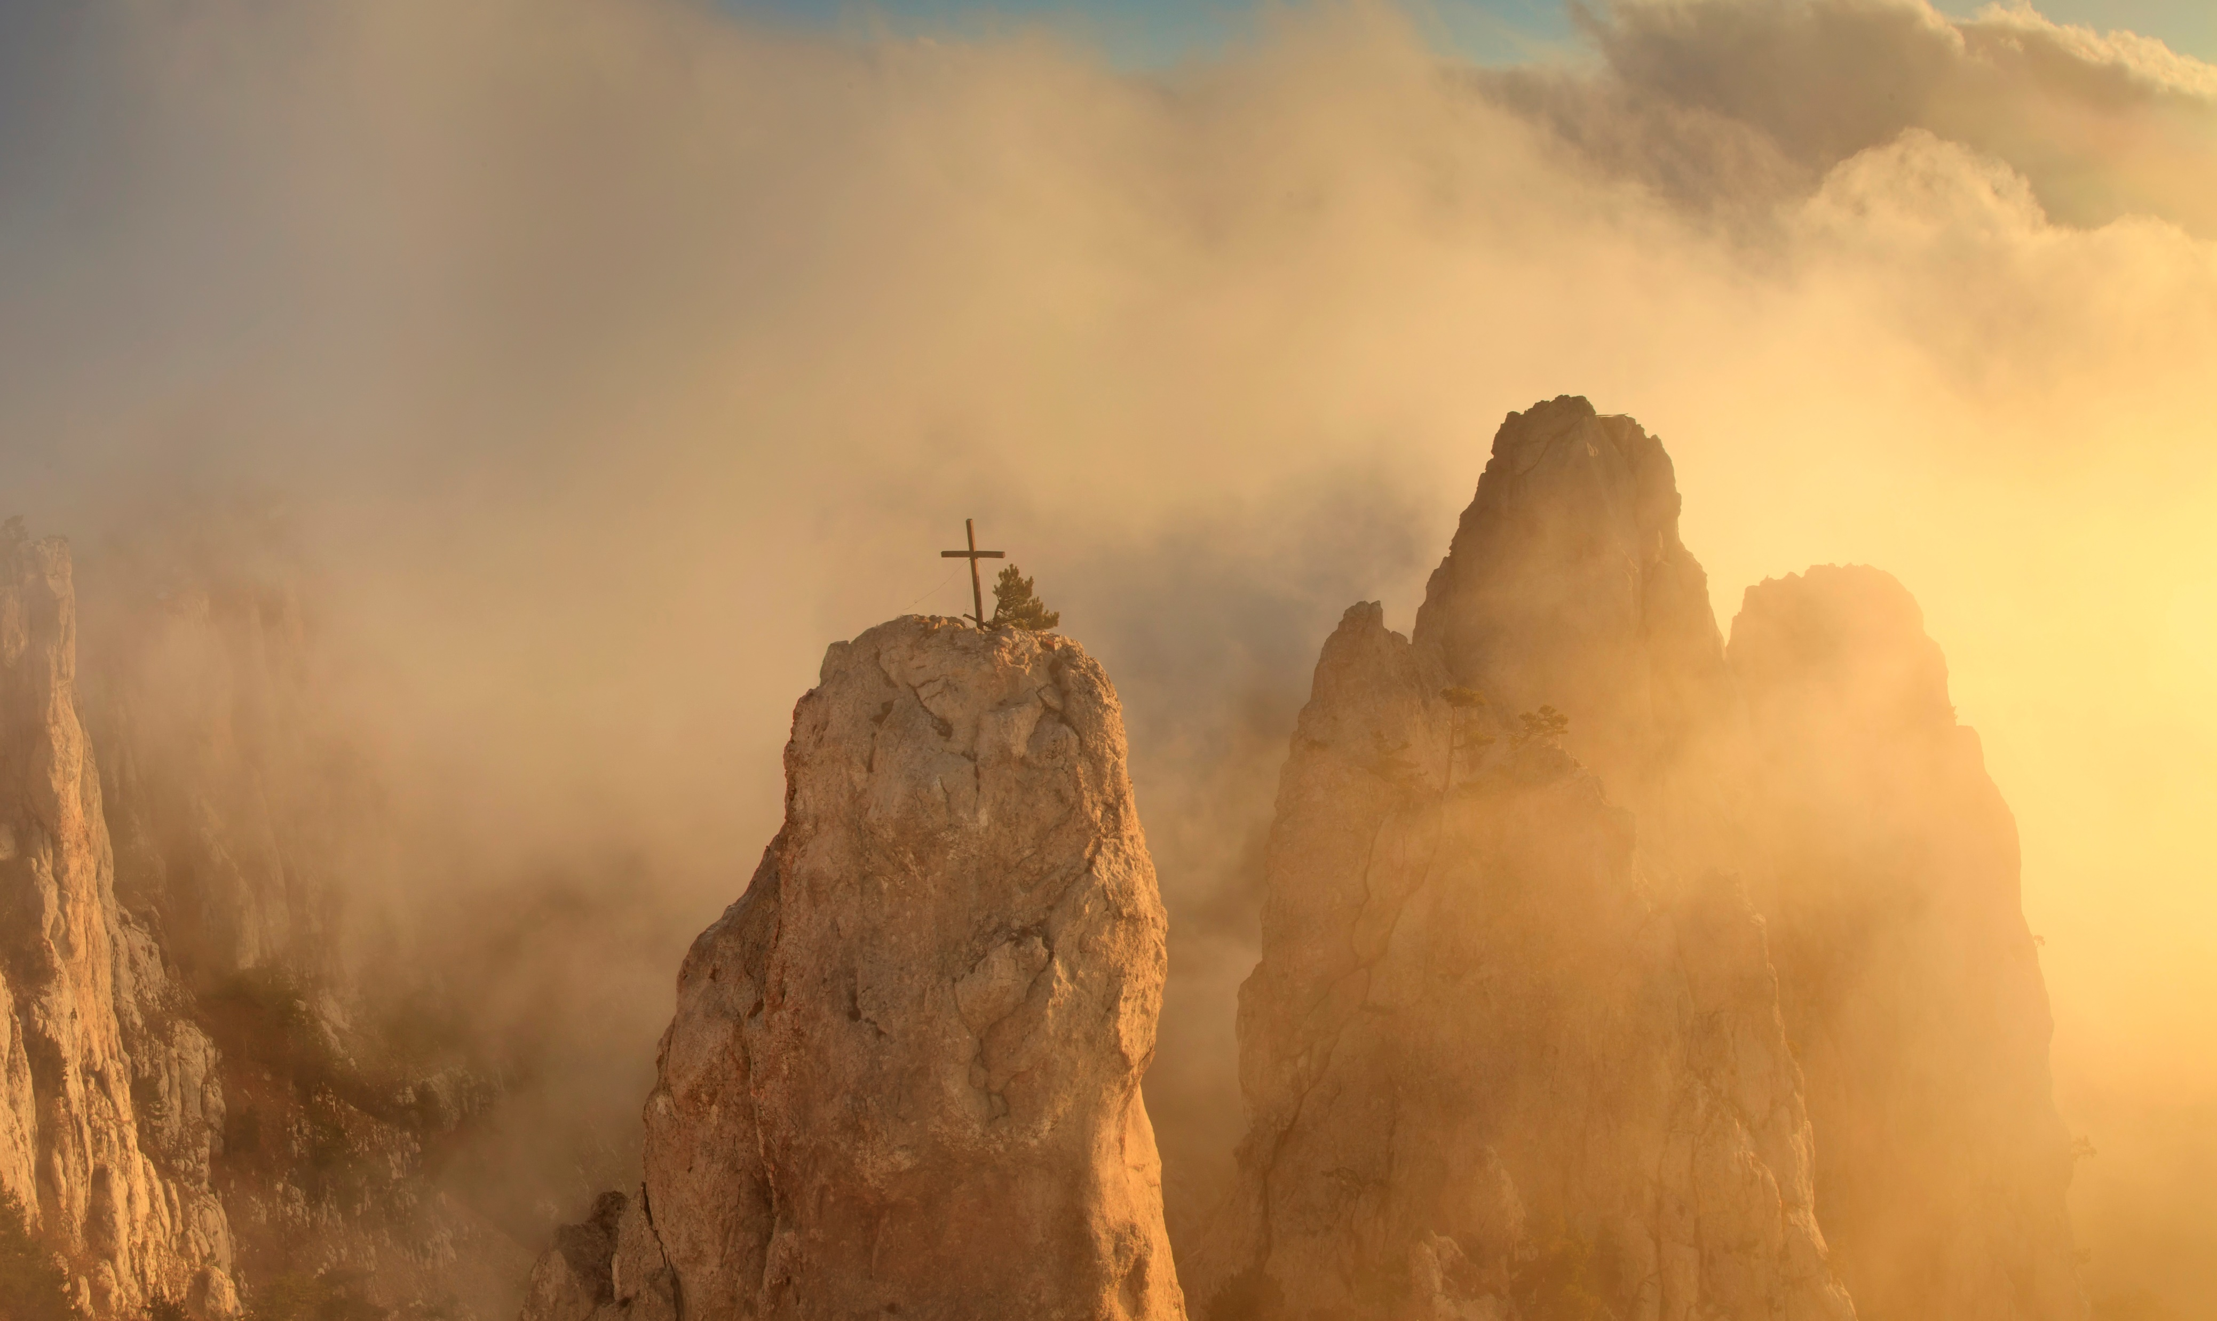
Prayer Requests
Tony and Cayse DeGonia
Pray for Israel
Pray for the United States
Our first responders
Our Military
Elected leaders
For our church to grow and bring glory to GOD.
Notes:
Miss Margaret
Mrs. Helen Brand
Gail Brand (Brother Dale’s daughter-in-law)
Pray for Israel
Pray for the United States, and our first responders, who are under attack too often.
Our military and our leaders
Tony and Cayse DeGonia – Pray for Tony to be blessed with gainful employment again soon.

Slide 9
Announcements

Slide 10
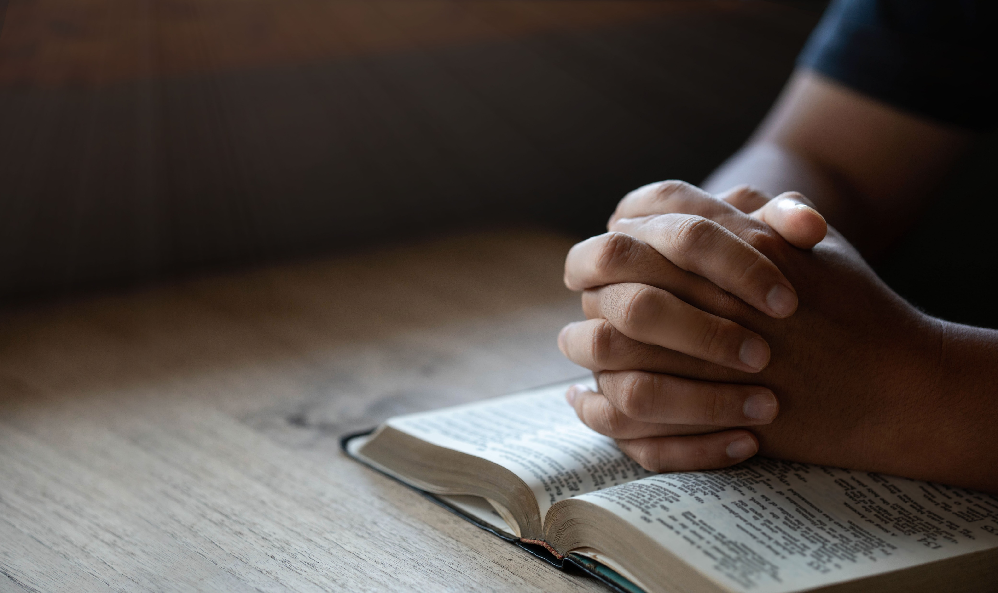
Announcements
Happy New Year
The second (2nd) Saturday of each month we will be holding a men’s meeting @ 5 PM.
Don’t forget about our new website @https://www.abner-baptist.org

Slide 11

Let’s get ready to
O How I Love Jesus #131
Specials
Tis So Sweet to Trust in Jesus #104
Just As I Am #124

Slide 12
Do we have any specials?
Specials
Sunday, January 7, 2024

Slide 13
O How I Love Jesus
#131
in our blue hymnals
Notes:
There is Power in the Blood #101
Nothing But the Blood #122
O How I Love Jesus #131

Slide 14
#131 O How I Love Jesus
There is a name I love to hear,
I love to sing its worth;
it sounds like music in my ear,
the sweetest name on earth.

Slide 15
#131 O How I Love Jesus
Refrain:
O how I love Jesus,
O how I love Jesus,
O how I love Jesus,
because he first loved me!

Slide 16
#131 O How I Love Jesus
It tells me of a Savior's love,
who died to set me free;
it tells me of his precious blood,
the sinner's perfect plea.

Slide 17
#131 O How I Love Jesus
Refrain:
O how I love Jesus,
O how I love Jesus,
O how I love Jesus,
because he first loved me!

Slide 18
#131 O How I Love Jesus
It tells of one whose loving heart
can feel my deepest woe;
who in each sorrow bears a part
that none can bear below.

Slide 19
#131 O How I Love Jesus
Refrain:
O how I love Jesus,
O how I love Jesus,
O how I love Jesus,
because he first loved me!

Slide 20
Specials
Notes:
There is Power in the Blood #101
Nothing But the Blood #122
O How I Love Jesus #131

Slide 21
Tis So Sweet to Trust in Jesus
#104
in our blue hymnals
Notes:
Specials Request
O How I Love Jesus #131
Specials
Tis So Sweet to Trust in Jesus #104
Just As I Am #124
Softly and Tenderly #105

Slide 22
#104 There is Power in the Blood
'Tis so sweet to trust in Jesus,
and to take him at his word;
just to rest upon his promise,
and to know, "Thus saith the Lord."
Notes:
There is Power in the Blood #101
Nothing But the Blood #122
O How I Love Jesus #131

Slide 23
#104 There is Power in the Blood
Refrain:
Jesus, Jesus, how I trust him!
How I've proved him o'er and o'er!
Jesus, Jesus, precious Jesus!
O for grace to trust him more!
Notes:
There is Power in the Blood #101
Nothing But the Blood #122
O How I Love Jesus #131

Slide 24
#104 There is Power in the Blood
O how sweet to trust in Jesus,
just to trust his cleansing blood;
and in simple faith to plunge me
neath the healing, cleansing flood!

Slide 25
#104 There is Power in the Blood
Refrain:
Jesus, Jesus, how I trust him!
How I've proved him o'er and o'er!
Jesus, Jesus, precious Jesus!
O for grace to trust him more!
Notes:
There is Power in the Blood #101
Nothing But the Blood #122
O How I Love Jesus #131

Slide 26
#101 There is Power in the Blood
Yes, 'tis sweet to trust in Jesus,
just from sin and self to cease;
just from Jesus simply taking
life and rest, and joy and peace.
Notes:
There is Power in the Blood #101
Nothing But the Blood #122
O How I Love Jesus #131

Slide 27
#104 There is Power in the Blood
Refrain:
Jesus, Jesus, how I trust him!
How I've proved him o'er and o'er!
Jesus, Jesus, precious Jesus!
O for grace to trust him more!
Notes:
There is Power in the Blood #101
Nothing But the Blood #122
O How I Love Jesus #131

Slide 28
Offering
Scott and Walter

Slide 29
Just As I Am
#124
in our blue hymnals
Notes:
Specials Request
O How I Love Jesus #131
Specials
Tis So Sweet to Trust in Jesus #104
Just As I Am #124
Softly and Tenderly #105

Slide 30
#124 Just As I Am
Just as I am, without one plea,
but that thy blood was shed for me,
and that thou bidd'st me come to thee,
O Lamb of God, I come, I come.

Slide 31
#124 Just As I Am
Just as I am, and waiting not
to rid my soul of one dark blot,
to thee, whose blood can cleanse each spot,
O Lamb of God, I come, I come.

Slide 32
#124 Just As I Am
Just as I am, though tossed about
with many a conflict, many a doubt,
fightings and fears within, without,
O Lamb of God, I come, I come.

Slide 33
#124 Just As I Am
Just as I am, thou wilt receive,
wilt welcome, pardon, cleanse, relieve;
because thy promise I believe,
O Lamb of God, I come, I come.

Slide 34
Prayer for today’s message
Today’s Message

Slide 35
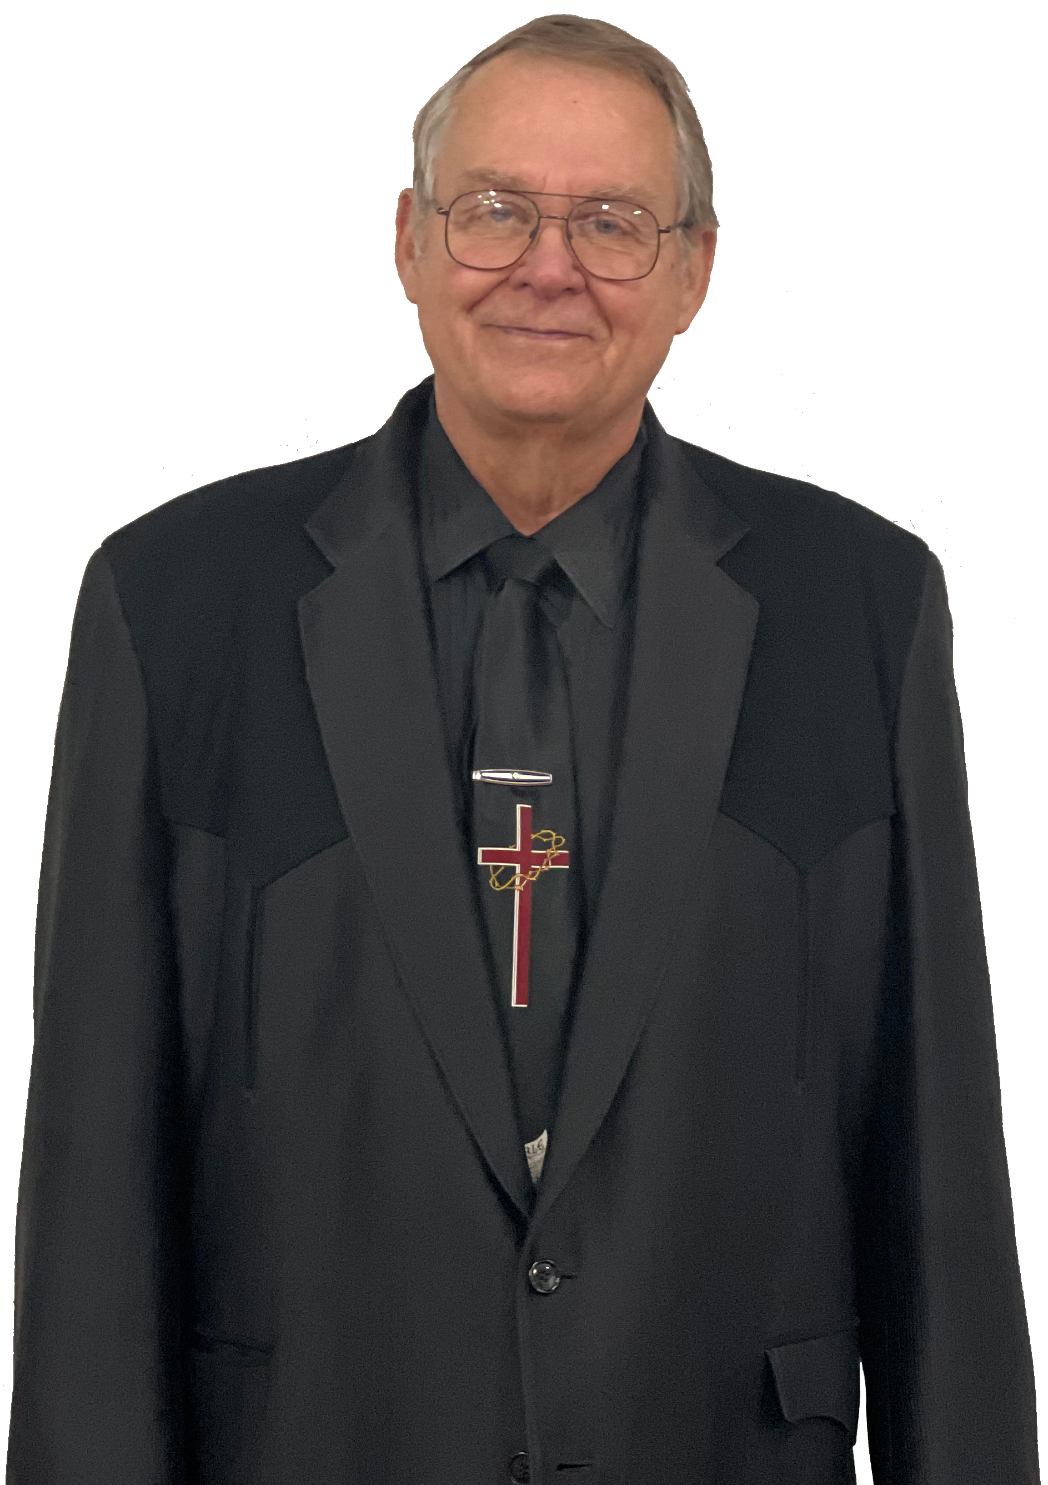
A Vision Begins With A Prayer.
Today’s Message
Brother Dale Brand

Slide 36
Today’s Message
Nehemiah 1: 1-3
1 The words of Nehemiah son of Hakaliah:
In the month of Kislev in the twentieth year, while I was in the citadel of Susa, ² Hanani, one of my brothers, came from Judah with some other men, and I questioned them about the Jewish remnant that had survived the exile, and also about Jerusalem.
³ They said to me, “Those who survived the exile and are back in the province are in great trouble and disgrace. The wall of Jerusalem is broken down, and its gates have been burned with fire.”

Slide 37
Today’s Message
Nehemiah 1: 4-6
⁴ When I heard these things, I sat down and wept. For some days I mourned and fasted and prayed before the God of heaven. ⁵ Then I said: “Lord, the God of heaven, the great and awesome God, who keeps his covenant of love with those who love him and keep his commandments, ⁶ let your ear be attentive and your eyes open to hear the prayer your servant is praying before you day and night for your servants, the people of Israel. I confess the sins we Israelites, including myself and my father’s family, have committed against you.

Slide 38
Today’s Message
Nehemiah 1: 7-9
⁷ We have acted very wickedly toward you. We have not obeyed the commands, decrees and laws you gave your servant Moses.
⁸ “Remember the instruction you gave your servant Moses, saying, ‘If you are unfaithful, I will scatter you among the nations, ⁹ but if you return to me and obey my commands, then even if your exiled people are at the farthest horizon, I will gather them from there and bring them to the place I have chosen as a dwelling for my Name.’

Slide 39
Today’s Message
Nehemiah 1: 10-11
¹⁰ “They are your servants and your people, whom you redeemed by your great strength and your mighty hand. ¹¹ Lord, let your ear be attentive to the prayer of this your servant and to the prayer of your servants who delight in revering your name. Give your servant success today by granting him favor in the presence of this man.”
I was cupbearer to the king.

Slide 40
Reason #1
A vision begins with a prayer

Slide 41
Today’s Message
a
When Nehemiah heard about Jerusalem.
b
What could he do?
c
Nehemiah did two things.

Slide 42
Reason #2
He Prayed.

Slide 43
Today’s Message
a
This is the first thing we should do.
b
He talked to God.
c
He waited on God, we are on God’s time-table not ours.

Slide 44
Reason #3
He Planned.

Slide 45
Today’s Message
a
He started planning on his next move.
b
We need to plan out the things ahead of us,
The cost?
The manpower? Do we have the strength to finish it.
c
Look at the resources
d
Put your plan in “Action”

Slide 46
Reason #3
God is using your circumstance.

Slide 47
Today’s Message
a
As a child of God, He needs to direct our paths.
b
Do you have a concern for the lost, dying souls?
c
Do you want to see our church to grow?
d
What can you do to help our church grow?

Slide 48
#105
Softly and Tenderly
Notes:
Specials Request
O How I Love Jesus #131
Specials
Tis So Sweet to Trust in Jesus #104
Just As I Am #124
Softly and Tenderly #105

Slide 49
#105 Softly and Tenderly
Softly and tenderly Jesus is calling,
calling for you and for me;
see, on the portals he's waiting and watching,
watching for you and for me.

Slide 50
#105 Softly and Tenderly
Refrain:
Come home, come home;
you who are weary come home;
earnestly, tenderly, Jesus is calling,
calling, O sinner, come home!

Slide 51
#105 Softly and Tenderly
Why should we tarry when Jesus is pleading,
pleading for you and for me?
Why should we linger and heed not his mercies,
mercies for you and for me?

Slide 52
#105 Softly and Tenderly
Refrain:
Come home, come home;
you who are weary come home;
earnestly, tenderly, Jesus is calling,
calling, O sinner, come home!

Slide 53
#105 Softly and Tenderly
Time is now fleeting, the moments are passing,
passing from you and from me;
shadows are gathering, deathbeds are coming,
coming for you and for me.

Slide 54
#105 Softly and Tenderly
Refrain:
Come home, come home;
you who are weary come home;
earnestly, tenderly, Jesus is calling,
calling, O sinner, come home!

Slide 55
#105 Softly and Tenderly
O for the wonderful love he has promised,
promised for you and for me!
Though we have sinned, he has mercy and pardon,
pardon for you and for me.

Slide 56
#105 Softly and Tenderly
Refrain:
Come home, come home;
you who are weary come home;
earnestly, tenderly, Jesus is calling,
calling, O sinner, come home!

Slide 57
In Closing
Let Us Pray.

Slide 58
Be Blessed
Have a safe trip home. We will see you here next Sunday.

Slide 59


